Slide 1

Effects of Dietary Fiber
Shanshan Du, zexin Xia, and Na Liu
December 10th, 2015

Slide 2
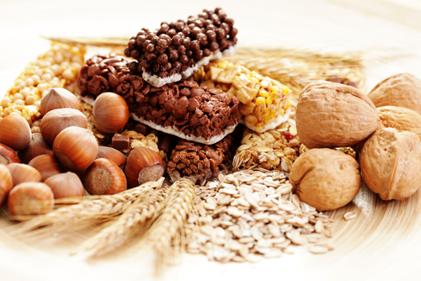
Introduction--Background Information
Dietary Fiber is important for your overall health.
Facilitating digestion
Eliminating waste
Theory claims that fiber can help to burn calories and lead to excess bloating.
Notes:
Dietary fiber can be found in plant foods such as fruits, vegetables, grains, nuts, and seeds. It is important for your overall health by facilitating digestion and eliminating waste from your body.
Many theories claim that high-fiber foods help you burn additional calories since they are difficult to be digested or absorbed. As a result, this can produce bloating and gassiness, particularly if you eat too much fiber.

Slide 3

Introduction--Research Questions
How are types of fiber in the cracker associated
with digested calories and bloating?
2) Do individual subjects vary in terms of
digested calories and bloating?

Slide 4
Introduction—Dataset
Sample size: 12 female subjects.
Control and treatment:
The subjects were fed with crackers containing,
bran fiber
gum fiber
a combination of both
no fiber (control)
Their caloric intake was monitored. Subjects reported any gastric or other problems.
Variable names:
Cracker: Type of fiber in the cracker
Subject: An identification for each of the 12 subjects
Digested: Digested calories. Difference between caloric intake and calories passed through system
Bloat: Degree of bloating and flatulence reported by the subjects
Notes:
Cracker: Type of fiber in the cracker -- categorical variable
Diet: One of four diets (type of cracker) -- categorical variable
Subject: An identification for each of the 12 subjects --categorical variable
Digested: Digested calories. Difference between caloric intake and calories passed through system --numerical variable
Bloat: Degree of bloating and flatulence reported by the subjects -- categorical variable

Slide 5

Data Analysis Methods
One-way ANOVA Test
Paired t test
Confidence Interval
Chi-Square of Independence
Chi-Square Goodness of Fit Test

Slide 6
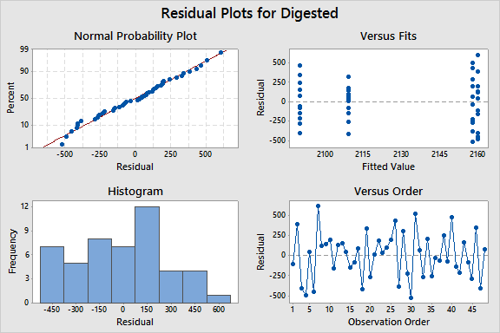
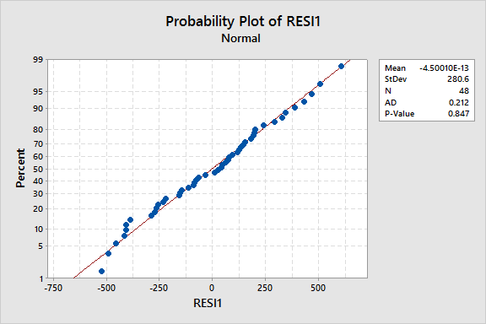
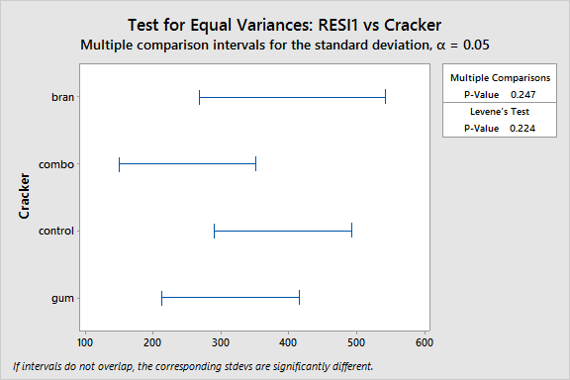
One-way ANOVA test: Cracker Fiber vs. Digested Calories
Check on the assumptions first:
We assume random sampling of all 4 sets of the measurements, equal population variances, and normality of the populations. The test results indicate that all three assumptions were met.
Notes:
Normality test p-value = 0.847
Test for equal variances p = 0.224

Slide 7

One-way ANOVA test: Cracker Fiber vs. Digested Calories
H₀: All means are equal.
H_{a}: At least one mean is different.
Significance level: α = 0.05
Test Statistic: Source DF Adj SS Adj MS F-Value P-Value
Diet 3 44639 14880 0.18 0.911
Error 44 3701094 84116
Total 47 3745733
Model Summary
S R-sq R-sq(adj) R-sq(pred)
290.027 1.19% 0.00% 0.00%
Results and Conclusion: Since P > 0.05, we fail to reject the null hypothesis. However, our adjusted R-sq is 0.00%, it means that none of the variability in digested calories can be explained by the cracker fiber.

Slide 8

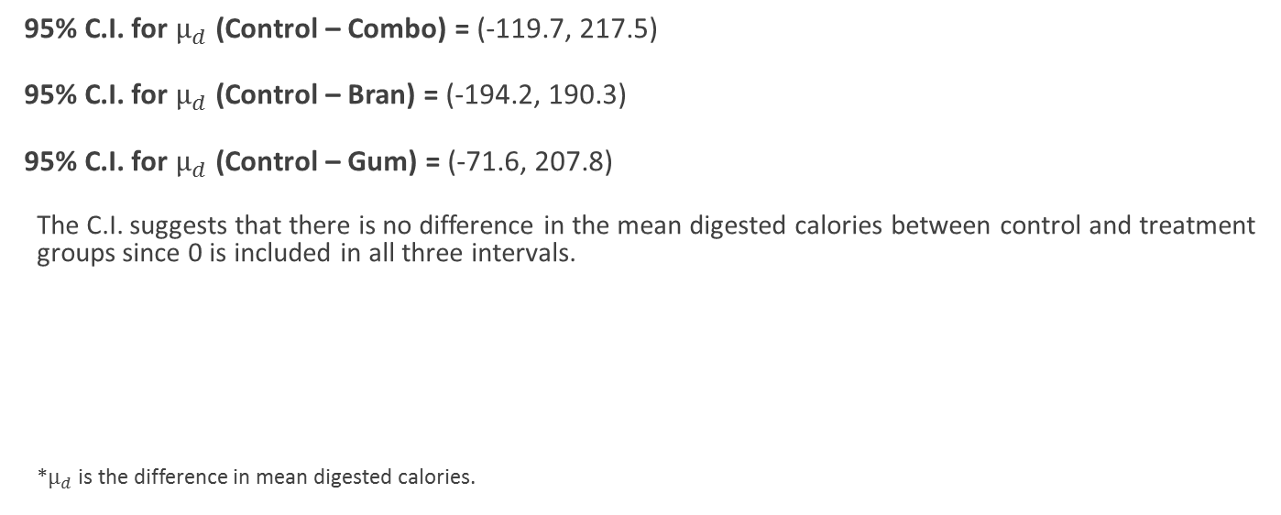
95% Confidence Interval for $μ_{d}$, Paired data
95% C.I. for $μ_{d}$ (Control – Combo) = (-119.7, 217.5)
95% C.I. for $μ_{d}$ (Control – Bran) = (-194.2, 190.3)
95% C.I. for $μ_{d}$ (Control – Gum) = (-71.6, 207.8)
The C.I. suggests that there is no difference in the mean digested calories between control and treatment groups since 0 is included in all three intervals.
*$μ_{d}$ is the difference in mean digested calories.
Notes:
We used one set of subjects for all 4 conditions. SO we constructed 3 separate CI’s between the control group and each of the 3 treatment groups.

Slide 9
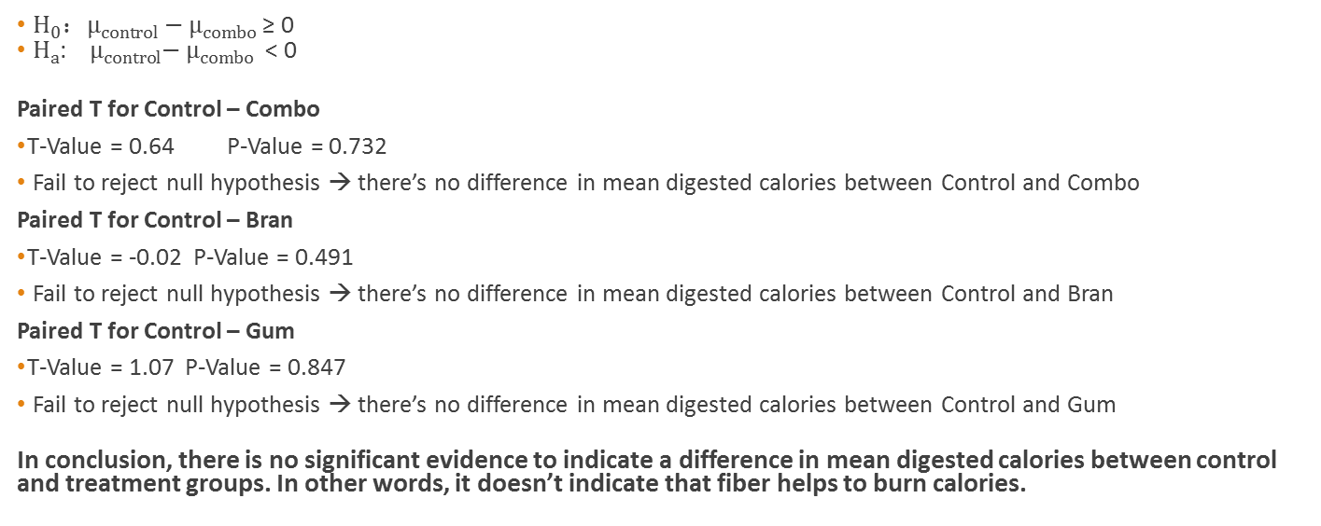
Paired t test for $μ_{d}$: Control vs. Combo, Gum, Bran
： ≥ 0
: < 0
Paired T for Control – Combo
T-Value = 0.64 P-Value = 0.732
Fail to reject null hypothesis → there’s no difference in mean digested calories between Control and Combo
Paired T for Control – Bran
T-Value = -0.02 P-Value = 0.491
Fail to reject null hypothesis → there’s no difference in mean digested calories between Control and Bran
Paired T for Control – Gum
T-Value = 1.07 P-Value = 0.847
Fail to reject null hypothesis → there’s no difference in mean digested calories between Control and Gum
In conclusion, there is no significant evidence to indicate a difference in mean digested calories between control and treatment groups. In other words, it doesn’t indicate that fiber helps to burn calories.
Notes:
To further confirm our conclusion from the C.I. we ran a paired t test on the mean difference.
This confirms the conclusion we obtained from the confidence interval.

Slide 10
Chi-Square of Independence: Cracker fiber vs. Bloating
H₀: Diet and bloating are independent.
H_{a}: Diet and bloating are dependent.
T.S.: Pearson Chi-Square = 16.943, DF = 9; P-Value = 0.050.
Results and Conclusions: Since Chi-square = 16.943 > 16.92, we have sufficient evidence that diet and bloating are dependent; however, 16 out of 16 cells with expected counts less than 5. So Chi-square of independence is an invalid test for these two sets of data.
Attempts to combine categories: We tried to re-organize the data in the variable “Bloating” to increase the expected cell counts. We combined “None” and “Low” into one category and “Med” and “High” into one; however, 50% of cells (4 out of 8) have expected counts less than 5. We also tried to combine “Low” to “High” together in comparison to “None”; however, 50% of cells (4 out of 8) have expected counts less than 5.
Notes:
Now we are analyzing the effect of fiber on bloating. Here we used Chi-square test of independence since both cracker fiber and bloating are categorical variables.

Slide 11
Chi-Square Goodness of fit: Cracker Fiber vs Bloating
H₀: The proportion of subjects with bloating is the same for all 4 groups.
H_{a}: At least one proportion is different.
T.S.Chi-Square = 2.677, DF = 3; P-Value = 0.444.
Results and Conclusions: Since P > 0.05, we fail to reject the null hypothesis and we can conclude that there is insignificant evidence to claim that different types of fiber has any effect on the bloating level of the subjects.
Notes:
Note: The test is used only to compare the proportion of subjects having bloating for all 4 groups, it does not provide any indication on the level of bloating associated with each diet.

Slide 12
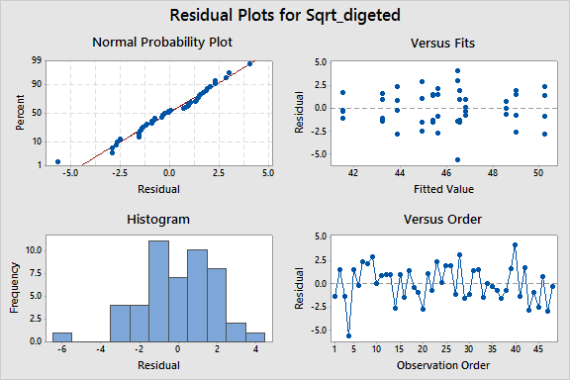
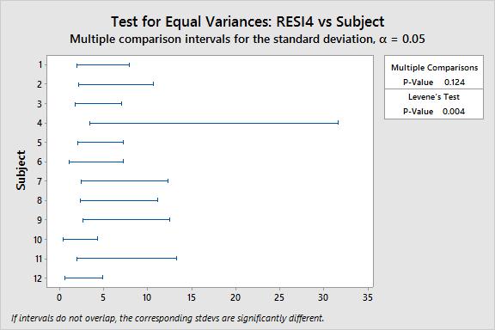
One-way ANOVA test: Subject vs. Digested Calories
Check on the assumptions first:
We assume random sampling of all 12 sets of the measurements, equal population variances, and normality of the populations. The test results indicate that the equal variance assumption was not met (P=0.004).
Notes:
2nd research questions – to see if there’s a difference in digested calories for each subject with same sets of treatments.

Slide 13
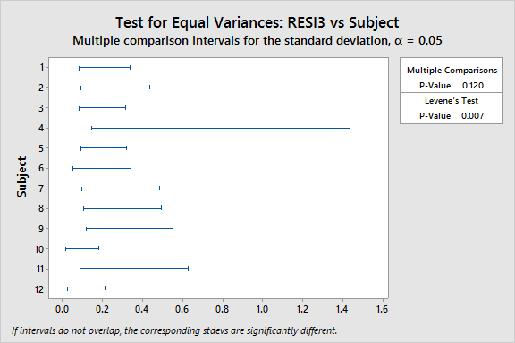
Transformation of Data -- Digested Calories
After Log transformation of data (P=0.007): After sqrt transformation of the data (P=0.004):
Notes:
Since it does not satisfy the assumption of equal variances, we cannot run Kruskal-Wallis test to compare the median digested calories for each subject.

Slide 14
One-way ANOVA test: Subject vs. Digested Calories (outlier removed)
Check on the assumptions first:
We assume random sampling of all 12 sets of the measurements, equal population variances, and normality of the populations. The test results indicate that the equal variance assumption was not met (P=0.030).
Notes:
2nd research questions – to see if there’s a difference in digested calories for each subject with same sets of treatments.

Slide 15
Transformation of Data -- Digested Calories (Outliner removed)
Normality Test of Residual ( P=0.703 ): After Log transformation of the data (P=0.068):
Notes:
Since it does not satisfy the assumption of equal variances, we cannot run Kruskal-Wallis test to compare the median digested calories for each subject.

Slide 16
One-way ANOVA test: Subjects vs. Digested Calories (outlier removed)
H₀: All means are equal.
H_{a}: At least one mean is different.
Significance level: α = 0.05
Test Statistic: Source DF Adj SS Adj MS F-Value P-Value
Subject 10 0.5175 0.051748 8.32 0.000
Error 33 0.2051 0.006217
Total 43 0.7226
Model Summary
S R-sq R-sq(adj) R-sq(pred)
0.0788456 71.61% 63.01% 49.53%
Results and Conclusion: Since P < 0.05, we reject the null hypothesis and we can conclude that there is significant evidence to indicate a difference in at least one of the means. In other words, there is a difference in digested calories among subjects.
Notes:
With r-sq = 62.92%, we can say that about 63% of the variability of digested calories can be explained by subjects.

Slide 17
Chi-Square of Independence: Subject vs. Bloating
H₀: Subject and bloating are independent.
H_{a}: Subject and bloating are dependent.
T.S.: Pearson Chi-Square = 39.570, DF = 33
Results and Conclusions:
* WARNING * 24 of 48 cells with expected counts less than 1.
* WARNING * Chi-Square approximation probably invalid

Slide 18
Conclusions
1. What is the association between cracker fiber and digested calories?
One-way ANOVA: Non-significant result, but adjusted R-sq is 0%.
Paired t test and CI: Non-significant result.
2. What is the association between cracker fiber and bloating?
Chi-square of Independence: Significant result, but all of the cells with expected counts less than 5, so the result might not be valid.
Chi-square goodness of fit test: Non-significant result.
3. Do individual subjects vary in terms of digested calories?
One-way ANOVA (Subject vs. Digested Calories—outlier removed): Significant result.
4. Do individual subjects vary in terms of bloating?
Chi-square of Independence: Half of the cells with expected counts less than 1, so the test won’t be valid.

Slide 19
Conclusions
In summary, based on our analysis of this dataset, fiber does not help to burn calories nor lead to excess bloating. However, the difference in digested calories can be explained to some extent by subjects.

Slide 20
References
http://healthyeating.sfgate.com/relieve-bloating-caused-much-fiber-4848.html
http://www.livestrong.com/article/322720-how-many-calories-are-burned-from-eating-fiber/

